Slide 1
Lecture LA08 – GridView
ITP271 : Web Application Development & Project

Slide 2
GridView
GridView can display Collection List objects with minimum coding too.
It uses reflection or introspection of object where it displays the value using object property method.
It handles the primitive data type automatically

Slide 3
GridView
Example UserFeedback object has the following property which returns a string value
  Comment
  Email
  Grade
GridView willl automatically display the above property and using its property name as heading text.

Slide 4
GridView
Customisation of GridView Heading and column sequence
TemplateField
ItemTemplate
<%#Eval(…)%>
Disable Auto-generated fields
Format GridView

Slide 5
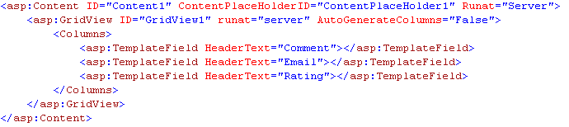
TemplateField

Slide 6
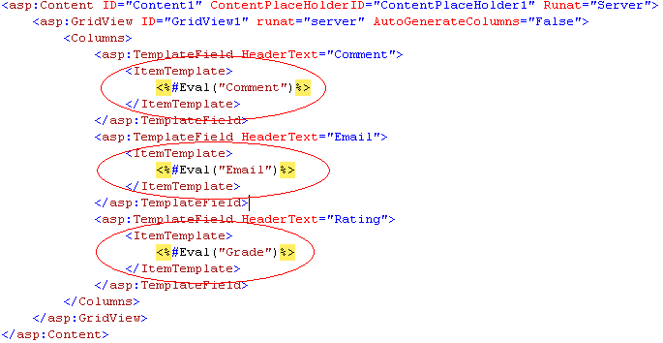
ItemTemplate

Slide 7
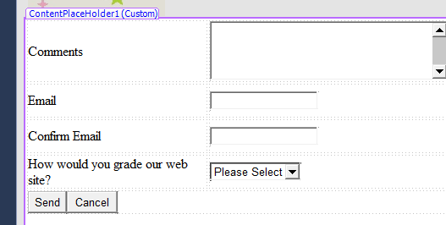
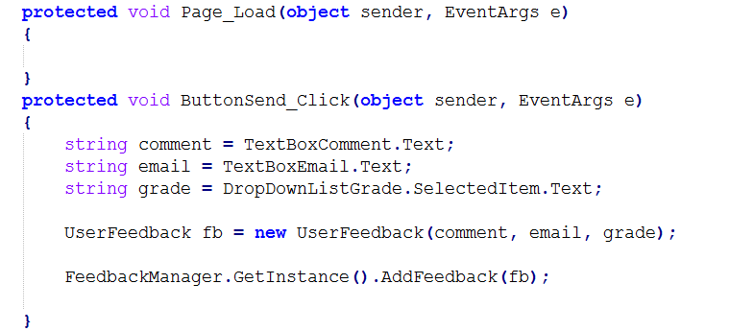
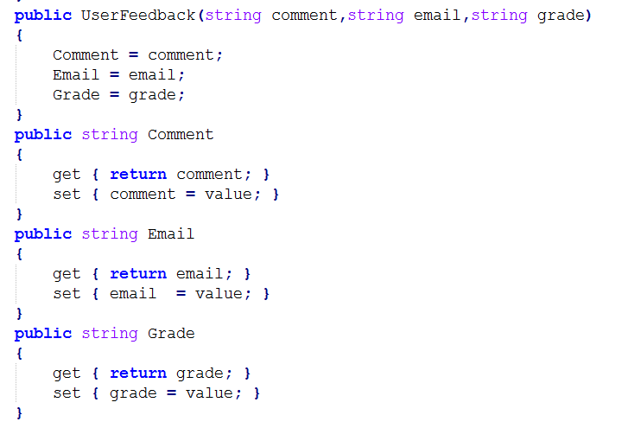
Eval
Eval function lets us evaluate a method call
The parameter refers to the property name of an object.
<%#Eval(“Comment”)%>
In the lab exercise, GridView is bind to List<UserFeedback> collection, the preceding Eval calls the Comment property in UserFeedback object.
UserFeedback.cs
Feedback.aspx.cs

Slide 8
Summary
In the practical, we will learn how to use the what we have learned
Binding GridView to List Collection

